Slide 1

Why people leave?
Human Resource analysis for explaining and predicting attrition rates
Notes:
30 sec

Slide 2
16% of our employees resigned
The purpose of our work is to understand who these people are and enable us to increase retention rates and be able to predict attrition rates.
To achieve that goal, we explore three key questions:
If the distance from home correlates to the attrition rate;
Which are the characteristics that better explain employee resignation;
What makes an employee want to keep working here.
Notes:
30 seg

Slide 3
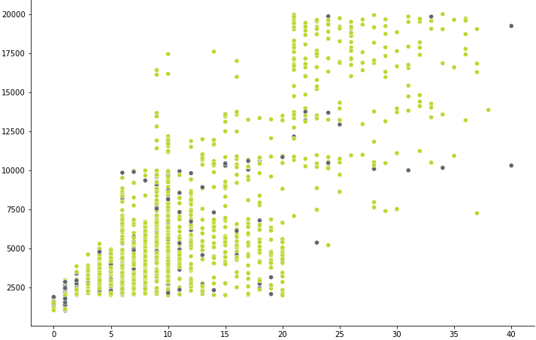
People with up to 20 years of experience and low salaries tend to resign more
Attrition distribution per monthly income and total working years
Key takeaways
Most resignations happen in the first 20 years of employment;
Most resignations happen in the lowest income levels;
This correlation does not imply that lower salaries cause more resignations.
Monthly income
Legend
Employed
Resigned
Total working years
Notes:
1 min

Slide 4
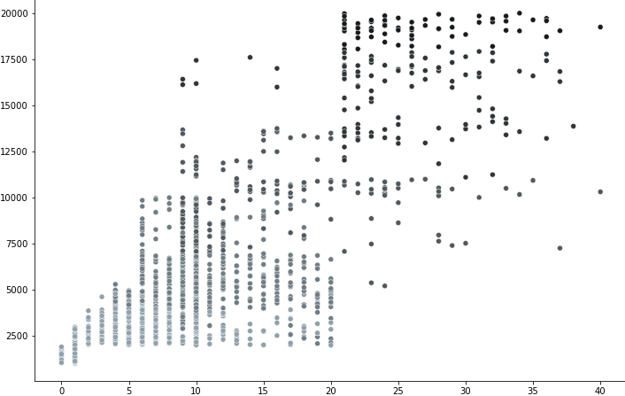
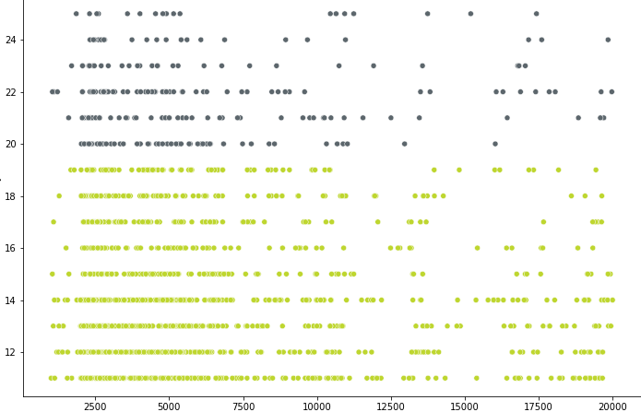
Raising wages is not always the easy way out
Job level per monthly income and total working years
Key takeaways
Most employees are concentrated in the first two job levels;
It takes time and experience to arrive at higher salary brackets;
Higher performance levels lead to higher salary hikes.
% salary hike per performance rating and monthly income
Performance rating
3
4
% salary hike
Monthly income
Job level
1
2
3
4
5
Monthly income
Total working years
Notes:
1 min 30

Slide 5
25% of frequent travelers resign
Job level per monthly income and total working years
Key takeaways
Most employees are concentrated in the first two job levels;
It takes time and experience to arrive at higher salary brackets;
Higher performance levels lead to higher salary hikes.
Monthly income
Job level
1
2
3
4
5
Total working years
Notes:
1 min 30

Slide 6
Intro e conclusões
Intro: o que estamos a responder “Why people leave?”
Conclusões (a distância está correlacionada)+ pontos que suportam
Exploração o que concluimos
Em que ponto do trabalho estamos
Slide do nosso processo
Our findings
Cronograma + Next Steps

Slide 7
Attrition is not related to distance from home
The purpose of our work is to understand who these people are and enable us to increase retention rates and be able to predict attrition rates.
To achieve that goal, we explore three key questions:
If the distance from home correlates to the attrition rate;
Which are the characteristics that better explain employee resignation;
What makes an employee want to keep working here.

Slide 8
Resignations are explained by
The purpose of our work is to understand who these people are and enable us to increase retention rates and be able to predict attrition rates.
To achieve that goal, we explore three key questions:
If the distance from home correlates to the attrition rate;
Which are the characteristics that better explain employee resignation;
What makes an employee want to keep working here.

Slide 9
Intro e conclusões
Intro: o que estamos a responder “Why people leave?”
Conclusões (a distância está correlacionada)+ pontos que suportam
Exploração o que concluimos
Em que ponto do trabalho estamos
Slide do nosso processo
Our findings
Cronograma + Next Steps

Slide 10
Intro e conclusões

